Slide 1
CS5010 Project
Rosé All Day

Slide 2
To Do:
Report Sections:
INTRODUCTION: describe your project scenario. Starting out, what did you hope to accomplish/learn?
THE DATA: Describe your data set and its significance. Where did you obtain this data set from? Why did you choose the data set that you did? Indicate if you carried out any pre- processing/data cleaning/outlier removal, etc... to sanitize your data
EXPERIMENTAL DESIGN: Describe briefly your process, starting from where you obtained your data all the way to means of obtaining results/output
BEYOND THE ORIGINAL SPECIFICATIONS: highlight clearly what things you did that went beyond the original specifications. That is, discuss what you implemented that would count towards the extra-credit portion of this project (see section below.)RESULTS: Display and discuss the results. Describe what you have learned and mention the relevance/significance of the results you have obtained. Be sure to use appropriate visualizations to display your results.
TESTING: Describe what testing you did. Describe the Unit tests that you wrote. Show a sample run of one or two of your tests (screen caps or copy-and-paste is fine)
CONCLUSIONS: Summarize your findings, explain how these results could be used by others (if applicable), describe ways you could improve your program or ways you might like to expand the functionality of your program if given more time
Write Up
Everyone writes about what they did
Do Intro and Conclusion together at the end
Presentation
Everyone make their own slides about what they worked on
Video
Use presentation as a guide

Slide 3
Outline
Notes from 2 Aug Call:
Paper Outline AND Presentation Outline (presentation no more than 20 mins)
Introduce data set and what it is
Introduce goals -- analyze reviewers, create recommendation system, create dashboard
Transformations on dataframe
End Product
Dashboard
Cards
Recommender
Future Things to do with the data
PPT
Flow chart of what we did
Screenshot of recommender
Some of the cards
Tableau Dashboard
Video of recommender

Slide 5
Short Presentation

Slide 6

Rosé All Day
Wine Recommender, Interactive Dashboard, & Reviewer Analysis
CS5010 Final Project, August 2020
Nikki Aaron, Bev Dobrenz, Amanda West, Joseph Wysocki
Notes:
Summer Wine Tasting Event | The Arts Center - Jamestown, ND

Slide 7
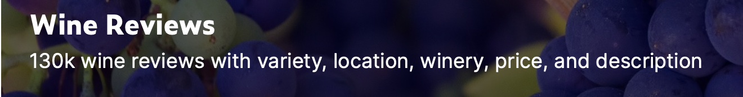
Introduction
Goal: Create a system that takes input from the user regarding their taste preferences and returns a list of recommended wines.
Dataset: WineEnthusiast Review Data from Kaggle
130k wine reviews with variables such as variety, location, winery, price, and description
Results: Users can:
Receive wine recommendations using a Terminal Input Wine Recommender
Obtain information about favorite wine tasters from Wine Reviewer Profiles
Visualize and interact with updated wine review data using a Tableau Dashboard

Slide 8
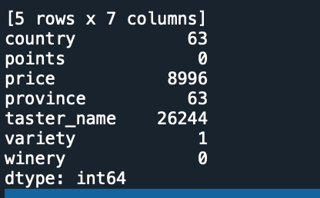
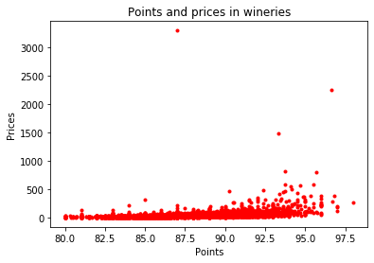
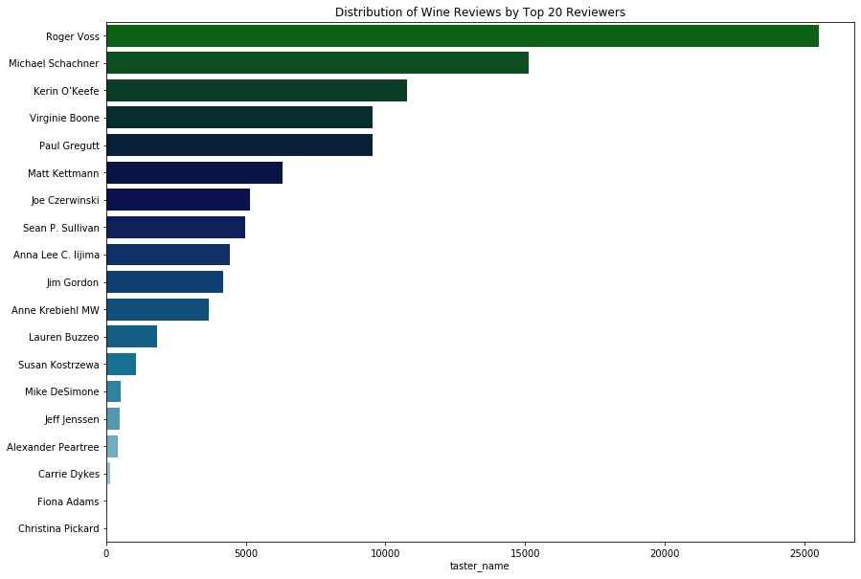
Data Cleaning/Initial Investigation
Wine Review Data from Kaggle
Winemag-data-130k-v2.csv with 130,000 rows of wine reviews
Variables include:
Country, Description, Points, Price, Province, Region_1, Region_2, Taster_Name, Taster_Twitter_Handle, Title, Variety, Winery
Created summary plots for initial investigation
Excluded missing (NaN) values: 96,400 rows to perform analysis
Are there any missing values?
Is there a relationship between price and points?
What taster writes the most reviews?

Slide 9
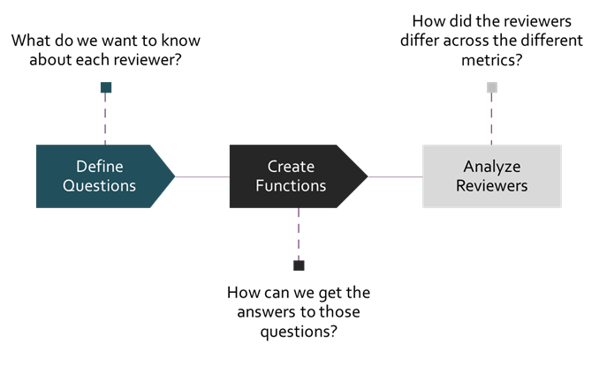
Wine Reviewer Profiles - Process

Slide 10
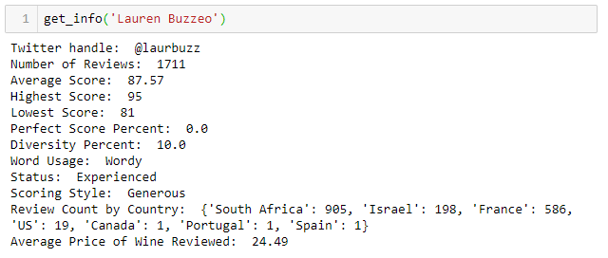
Wine Reviewer Profiles - Output

Slide 11
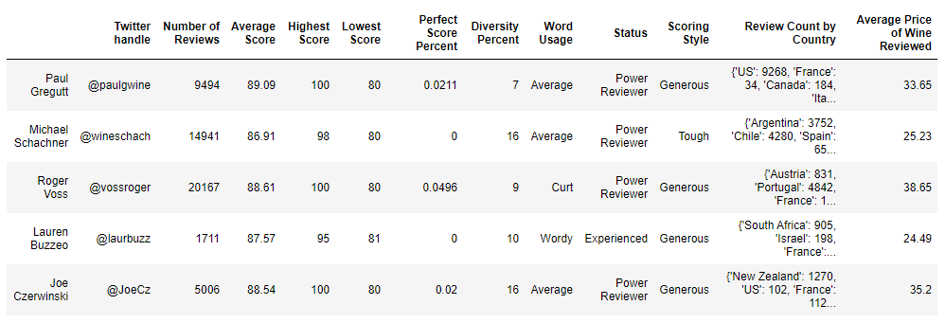
Wine Reviewer Profiles - Output

Slide 12
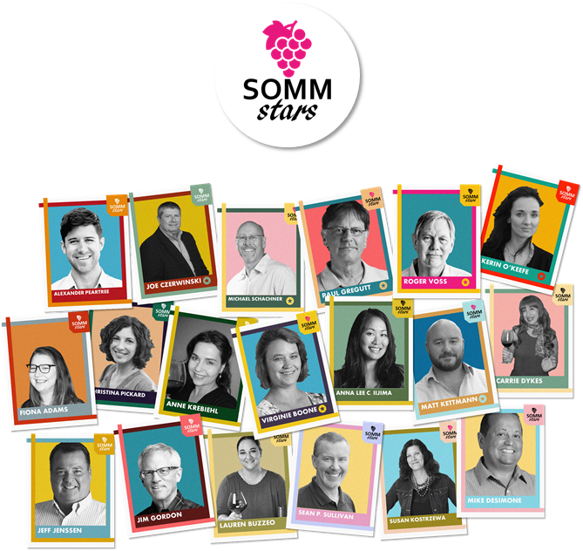
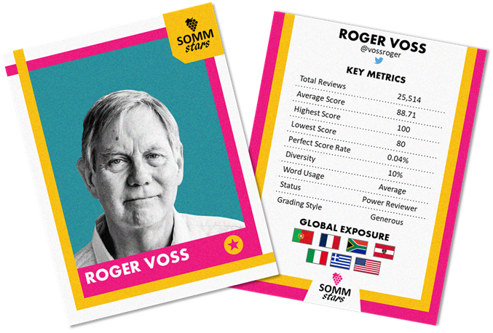

Slide 13
Wine Variety Analysis
Applying NLP to Wine Tasting Reviews
Identified the column of interest. ⇒ “The happy jumping dog”
Used tokenization to break up paragraph into a list of words. ⇒ [“The”, “happy”, “jumping”, “dog”]
Filtered out stop words from each list of text. ⇒ [“happy”, “jumping”, “dog”]
Appended the part-of-speech to each word. ⇒ [ [“happy”, ADJ], [“jumping”, V], [“dog”, N] ]
Filtered parts of speech for only nouns and adjectives. ⇒ [ [“happy”, ADJ], [“dog”, N] ]
* ADJ = Adjective, N = Noun, V = Verb

Slide 14

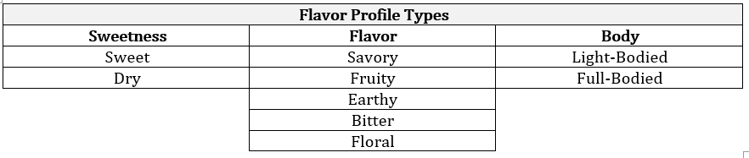
Wine Variety Analysis
Creating Wine Flavor Word Dictionary
“Fruity”, “Earthy”, “Floral”, “Bitter” examples of how one might describe a wine.
Created word lists for each category ⇒ [Fruity: “apple”, “pear”, “juicy”]
If descriptor list had enough matches, considered wine apart of that category.
Wine could live in more than one category (i.e. “sweet” and “earthy”)

Slide 15

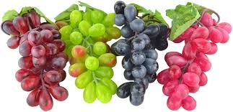
Wine Type Analysis
Identified the columns of interest -- title, designator, grape variety, description
Matched title and designator to list of color words in English, French, Italian, Spanish and German
Matched grape variety to list of grape variety colors
Matched description to list of color words
Count weighted matches and assign color with the highest count
Add “Blend” and “Sparkling” designations

Slide 16
Sample Recommendation
Cavas Hill NV 1887 Rosado Sparkling (Sparkling Rosé Blend from Spain) $13 | 82 Points | Sweet, Light-Bodied Red in color, with berry and apple aromas, this is a sweet blend, with a light body and nose tingling effervescence.

Slide 17
Wine Recommender Terminal App
Collect user preferences
Wine Type
Flavor Profile
Taster Score
Price Range
Origin Country
Display 10 Results
Wine Title
Wine Type
Flavor Profile
Taster Score
Price
Origin Country
Description
Pandas Filtering

Slide 18
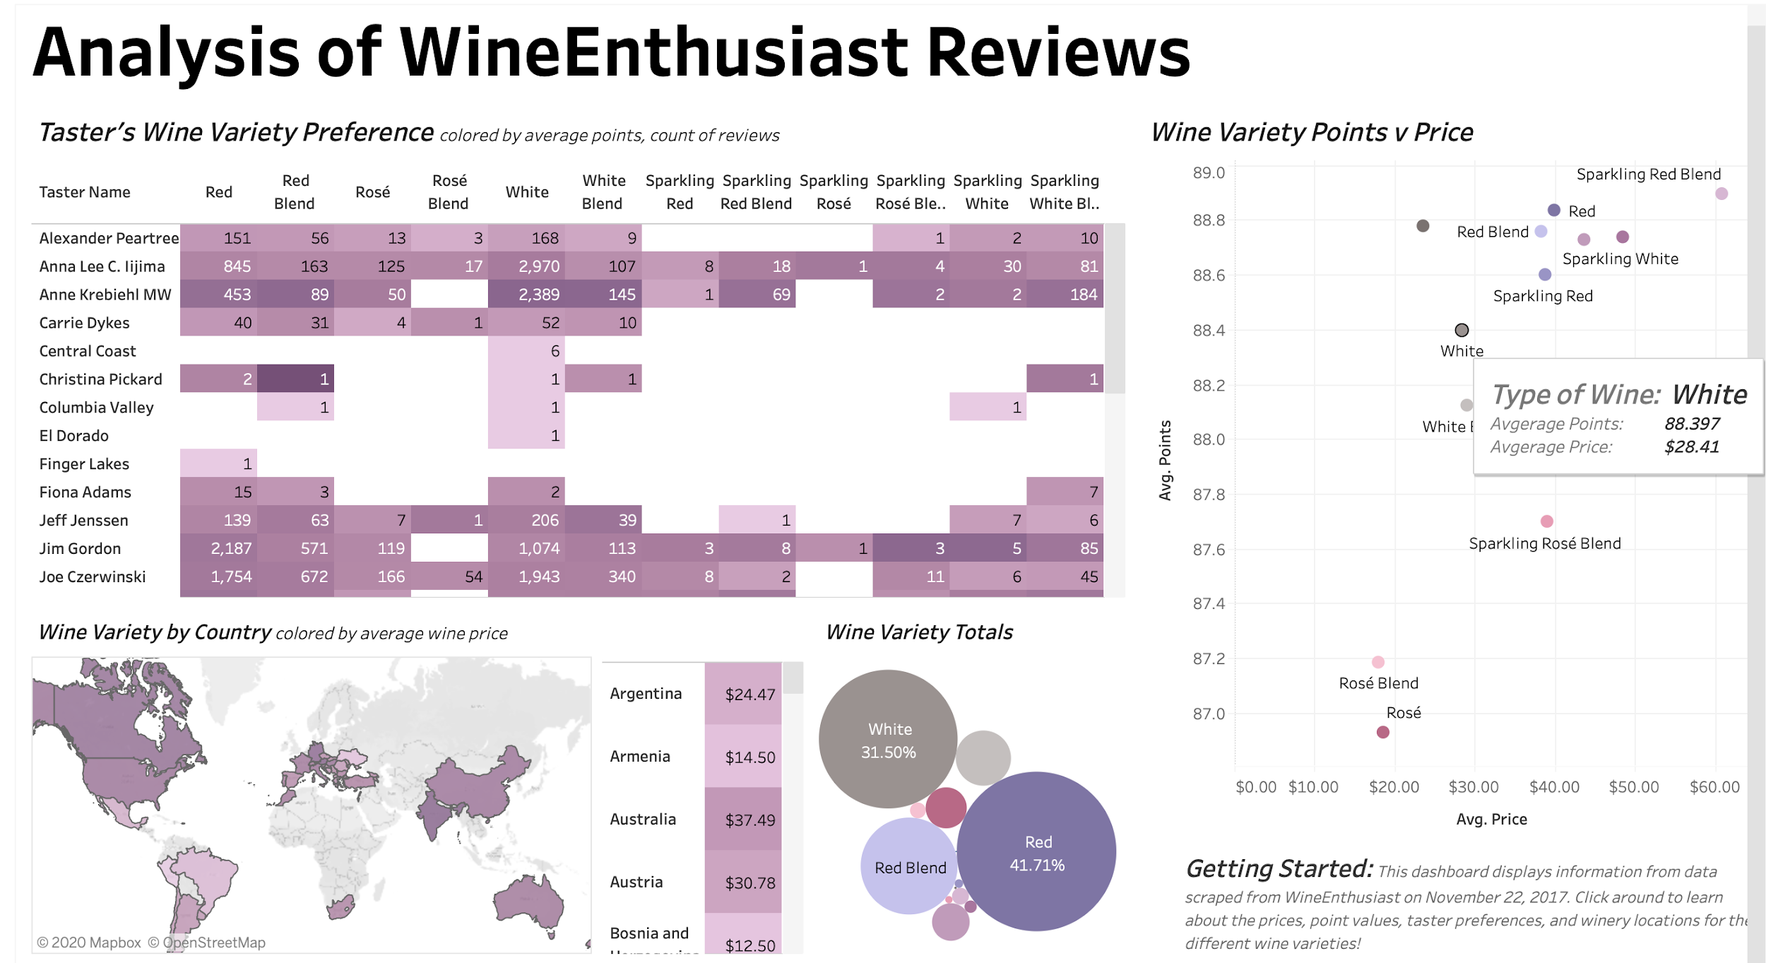
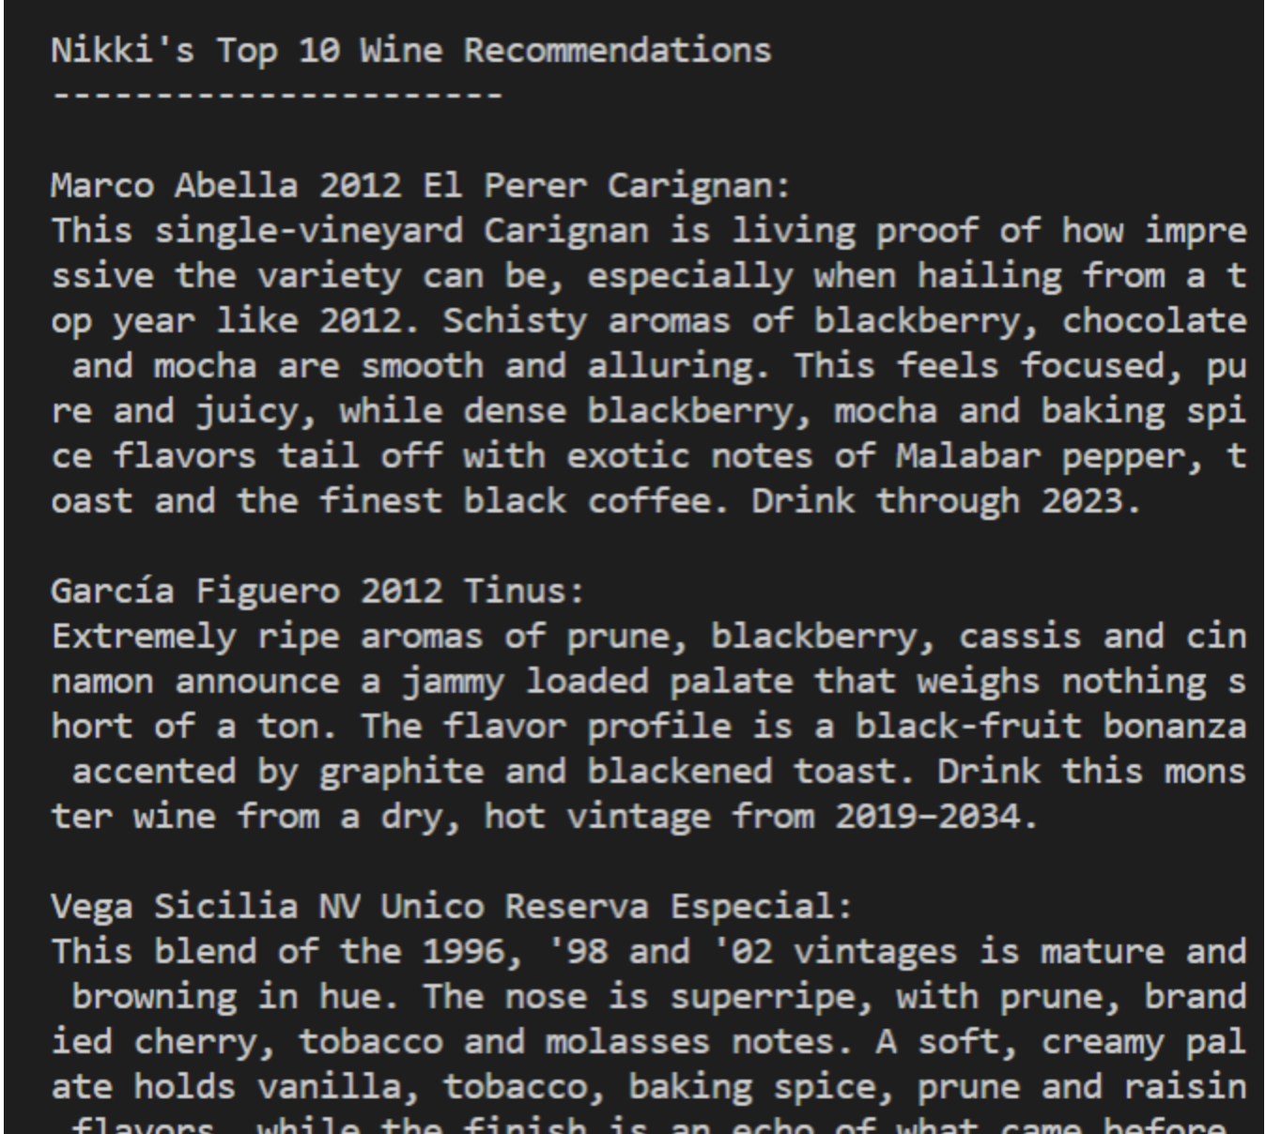
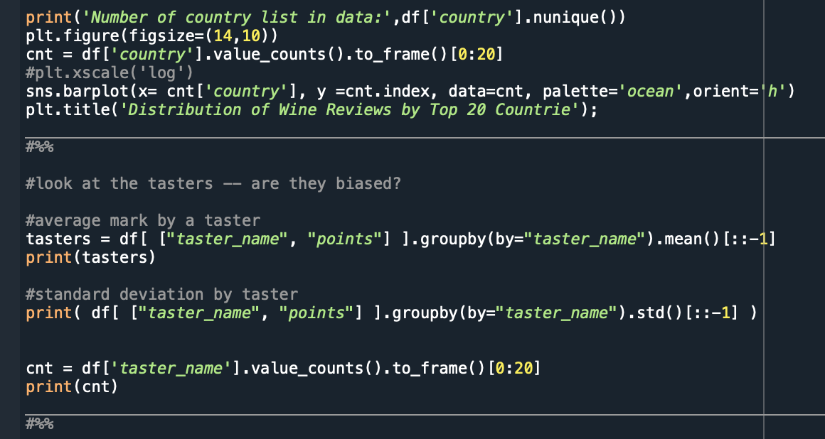


Tableau Dashboard
Tableau is a data visualization tool that makes it easy to create interactive visual analytics in the form of dashboards for both technical and non-technical end users.
Notes:
Once we finished the python portion with the wine recommender we wanted to explore visualization options. As an extra component for our project we created a tableau dashboard
Tableau is a data visualization tool that makes it easy to create interactive data analytics. Put the questioning power in the hands of the user.
Example on the next slide.

Slide 19
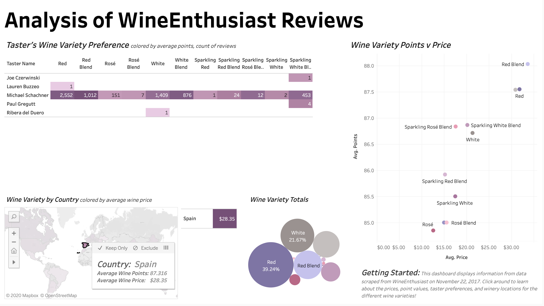
Tableau Dashboard: Use Case
User Input:
User selects Spain from the Map to display information about wine from Spain.
User Insights:
Spain has 9 varieties, with Red, White, and Red Blend accounting for over half of Spain’s total wine.
The most expensive wines from Spain are Red Blends. Red Blends also have, on average, the most points.
Five tasters have reviewed wine from Spain, with Michael Schachner having the most reviews -- does Michael try wines from other countries?
Original user input, user selects Spain
Notes:
User inputs spain
Can answer a lot of different questions

Slide 20
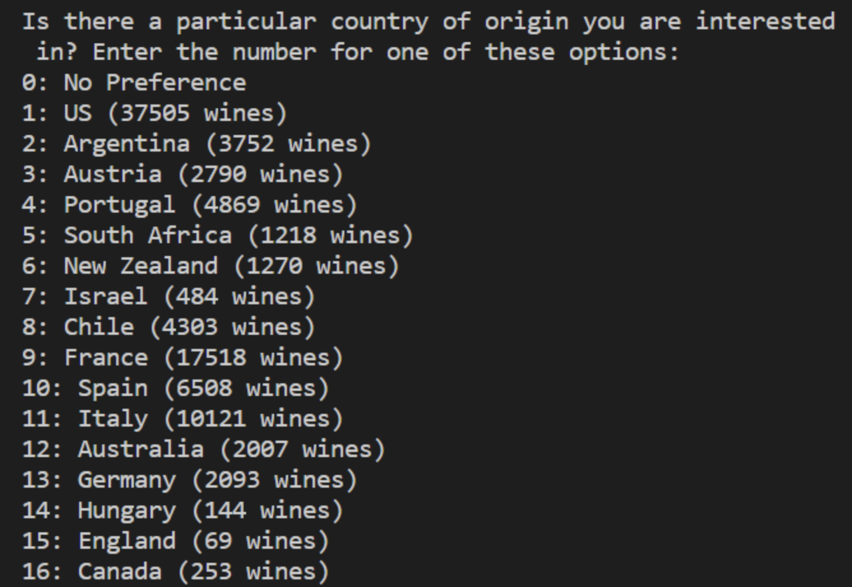

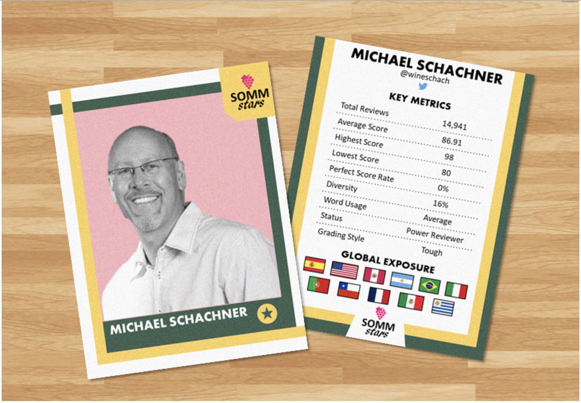
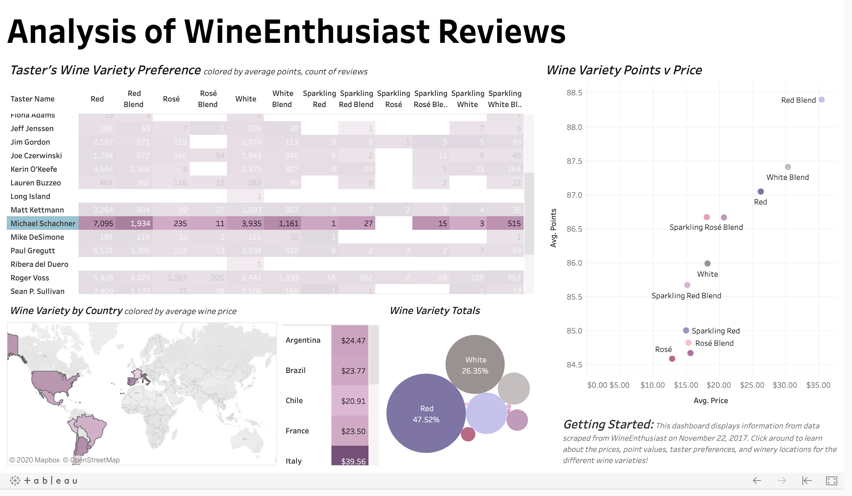

Putting it All Together: Sample Use Case
User is traveling to Spain and wants to learn about Spanish wines before their trip!
Data Scientists perform initial analysis, data transformations, and create a Wine Recommender
User specifies wine preferences and receives a Top Ten List of wine recommendations
User combines information from Wine Recommender and Tableau Dashboard to select a Taster Trading Card!
User uses Tableau Dashboard to dive deeper into their Top Ten List of wine recommendations
Notes:
https://www.gettyimages.com/illustrations/traveler?family=creative&mediatype=illustration&phrase=traveler&sort=mostpopular
Wine glasses clip art hostted 2 - Cliparting.com

Slide 21
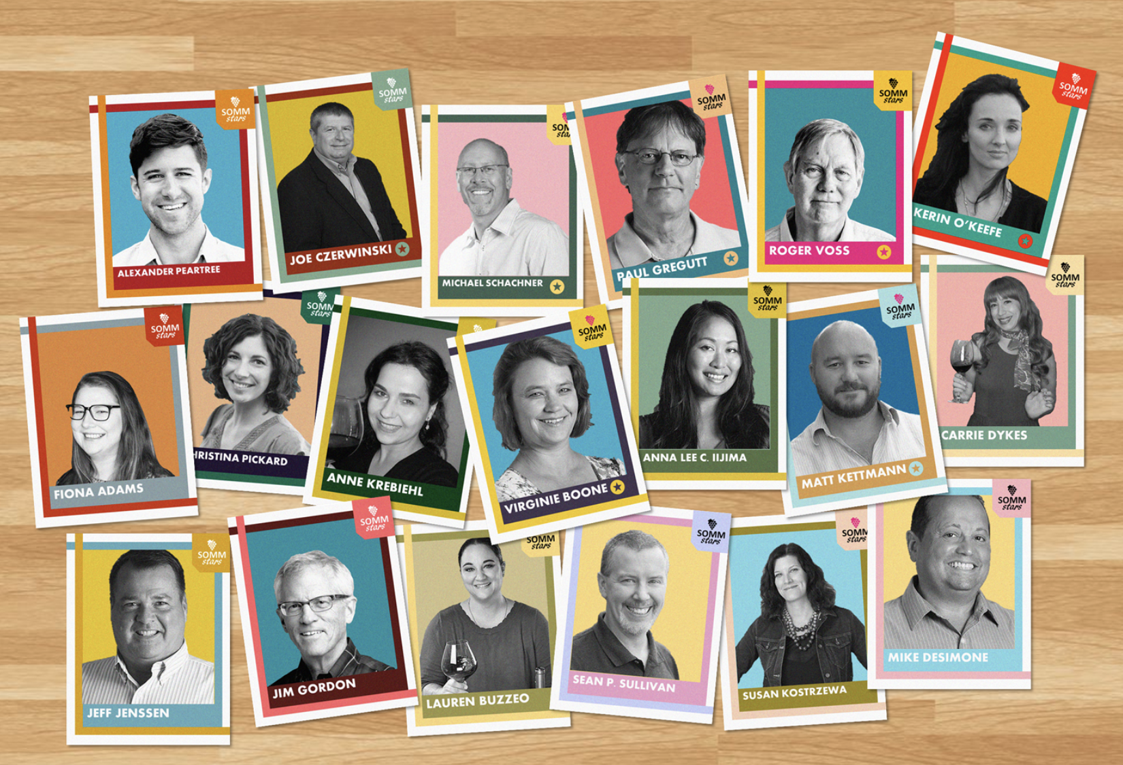
Conclusion
Goal: Create a system that takes input from the user regarding their taste preferences and returns a list of recommended wines.
Results:
Taster Profiles
Terminal Input Wine Recommender
WineEnthusiast Tableau Dashboard
Future Steps:
Web scrape updated wine reviews from Wine Enthusiast
Move from terminal environment into web format
Notes:
for more information about our process and unit testing refer to our final write up

Slide 22

Thank you!

Slide 23
Long Presentation

Slide 24
Rosé All Day
Wine Recommender, Interactive Dashboard, & Taster Trading Cards
CS5010 Final Project, August 2020
Nikki Aaron, Bev Dobrenz, Amanda West, Joseph Wysocki
Notes:
Summer Wine Tasting Event | The Arts Center - Jamestown, ND

Slide 25
Introduction
Goal: Create a system that takes input from the user regarding their taste preferences and returns a list of recommended wines.
Dataset: WineEnthusiast Review Data from Kaggle
130k wine reviews with variables such as variety, location, winery, price, and description
Results: Users can:
Receive wine recommendations using a Terminal Input Wine Recommender
Visualize and interact with updated wine review data using a Tableau Dashboard
Obtain information about favorite wine tasters from Taster Review Profiles

Slide 26
Project Flow Chart
Formulate Questions
Import
Dataset
Clean Data
Feature Enhancement
NLP
Visualization
Interactive
Programs

Slide 27
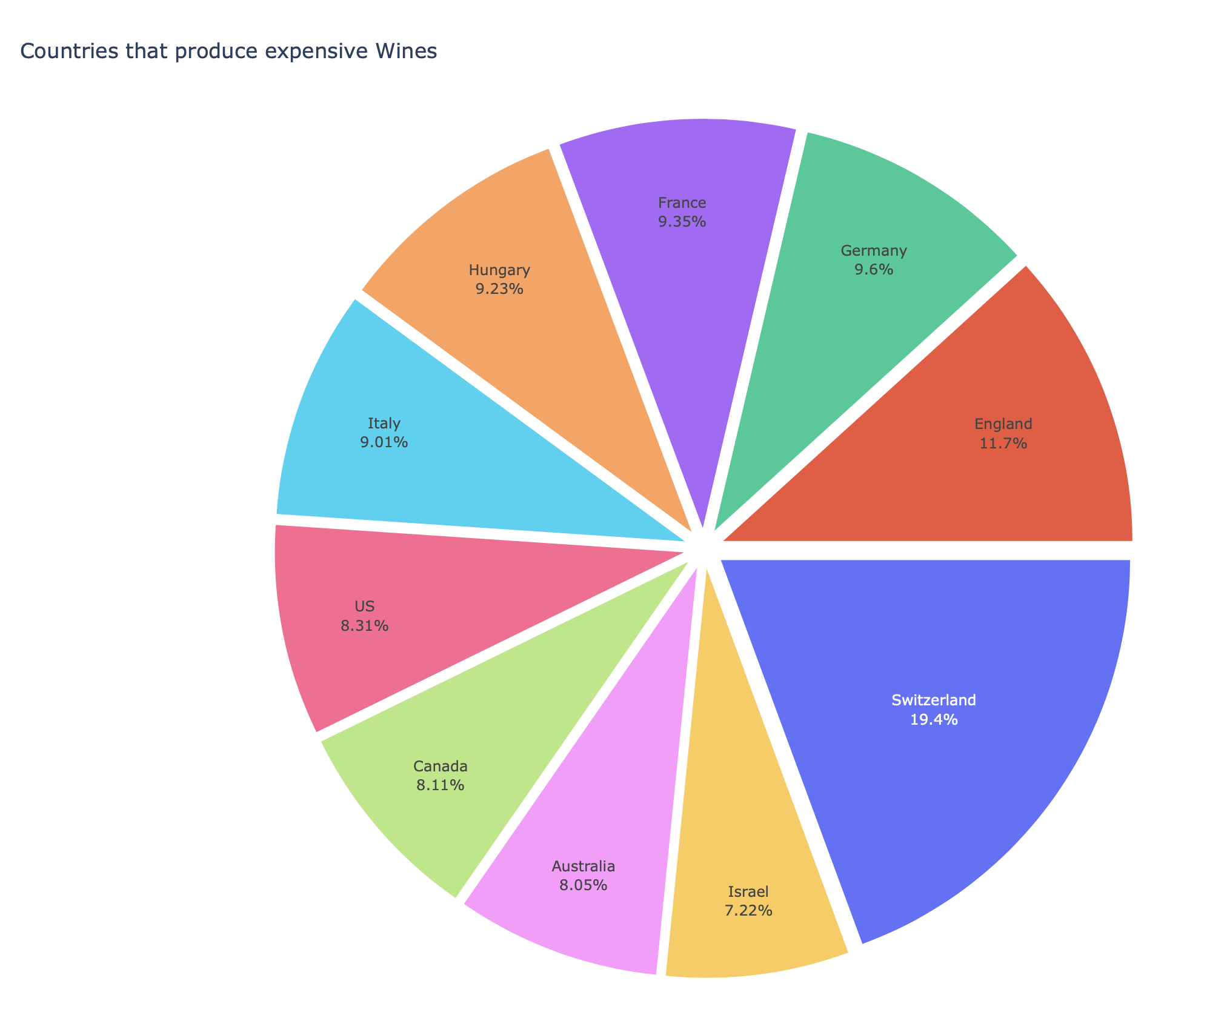
Data Cleaning/Initial Investigation
Wine Review Data from Kaggle
Winemag-data-130k-v2.csv with 130,000 rows of wine reviews
Variables include:
Country, Description, Points, Price, Province, Region_1, Region_2, Taster_Name, Taster_Twitter_Handle, Title, Variety, Winery
Created summary plots for initial investigation
Excluded missing (NaN) values: 96,400 rows to perform analysis
Are there any missing values?
Is there a relationship between price and points?
What taster writes the most reviews?
What Country has the most expensive wine?

Slide 28
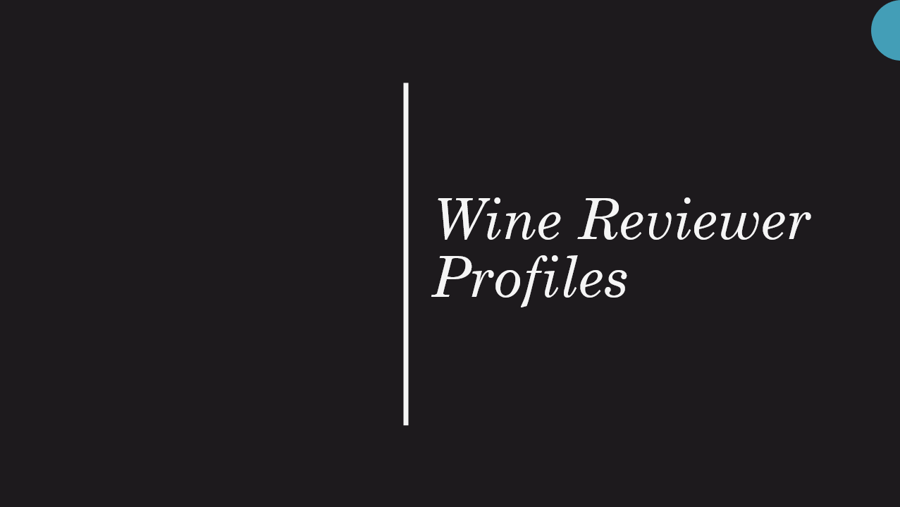

Slide 29
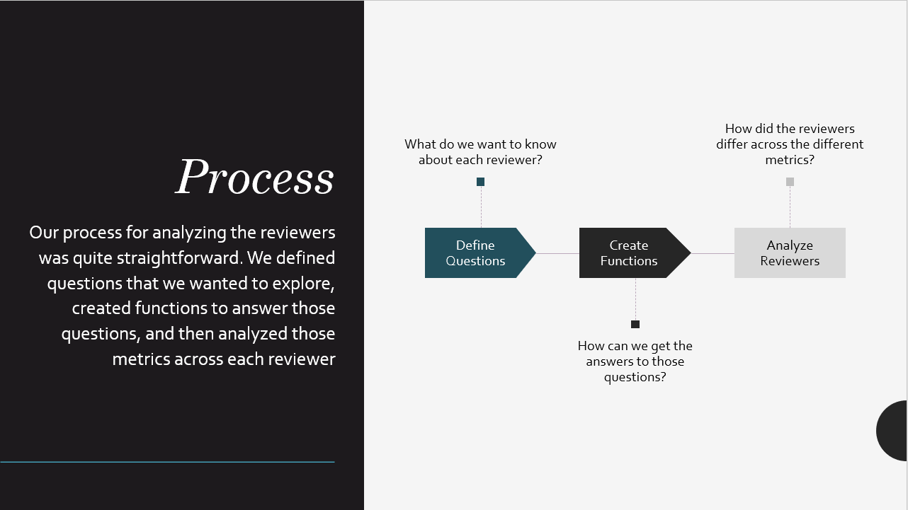

Slide 30
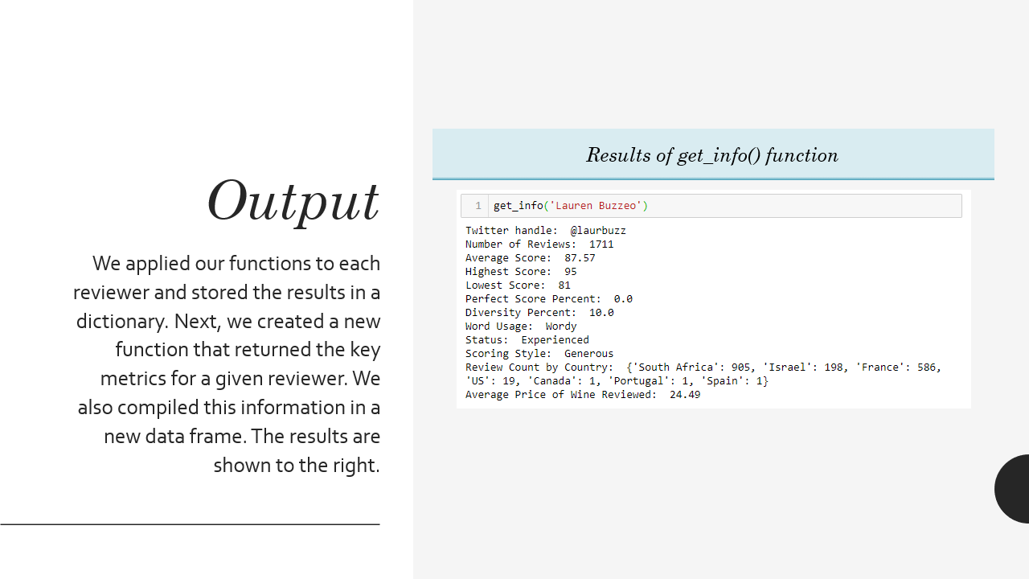

Slide 31
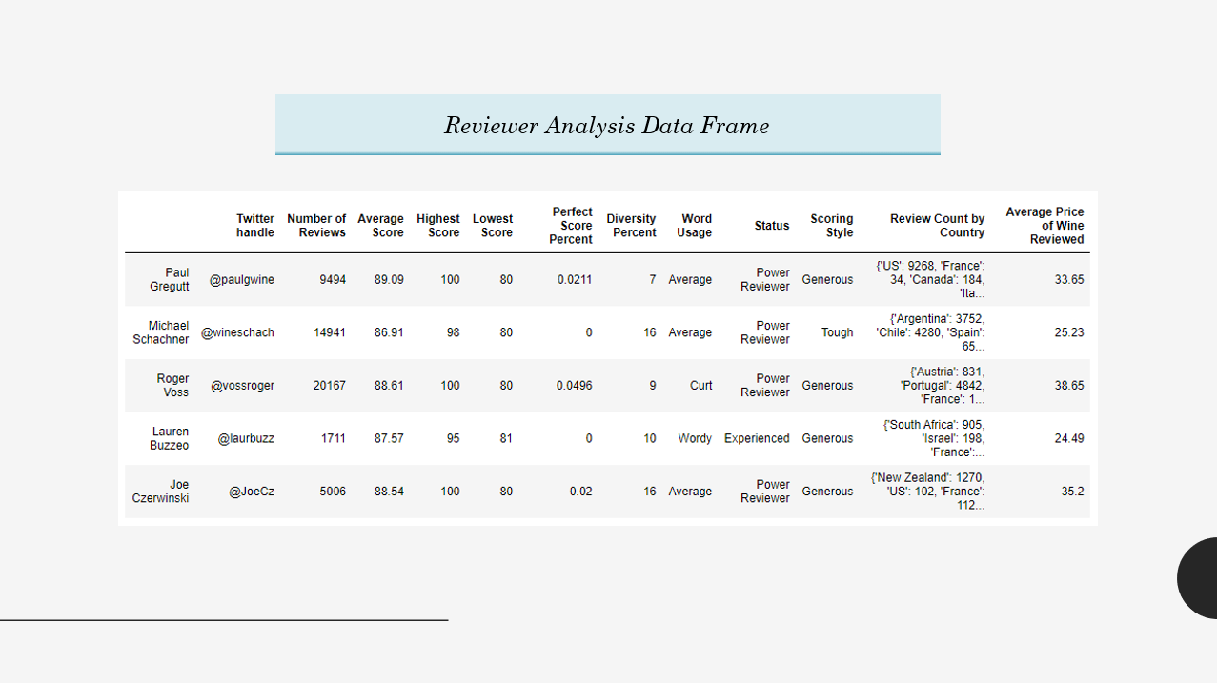

Slide 32
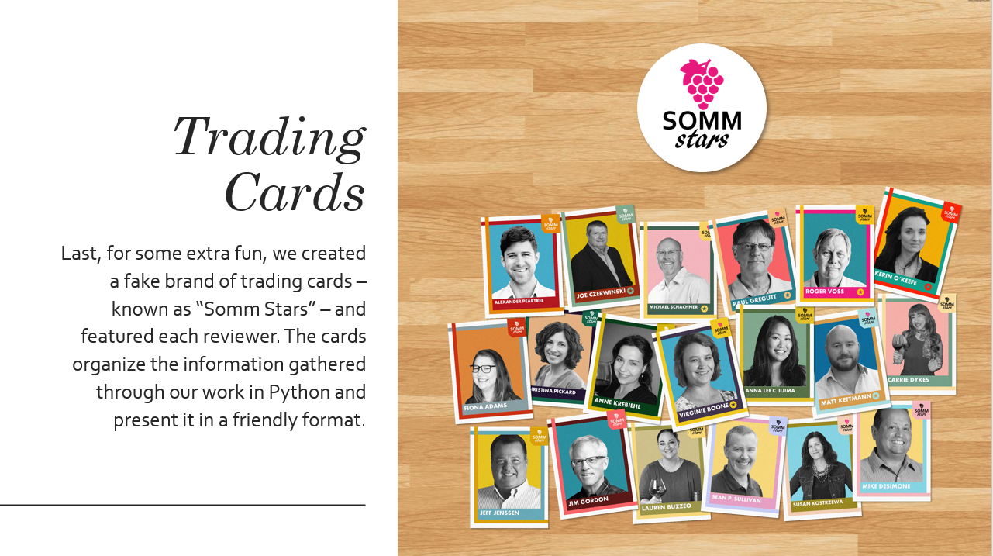

Slide 33
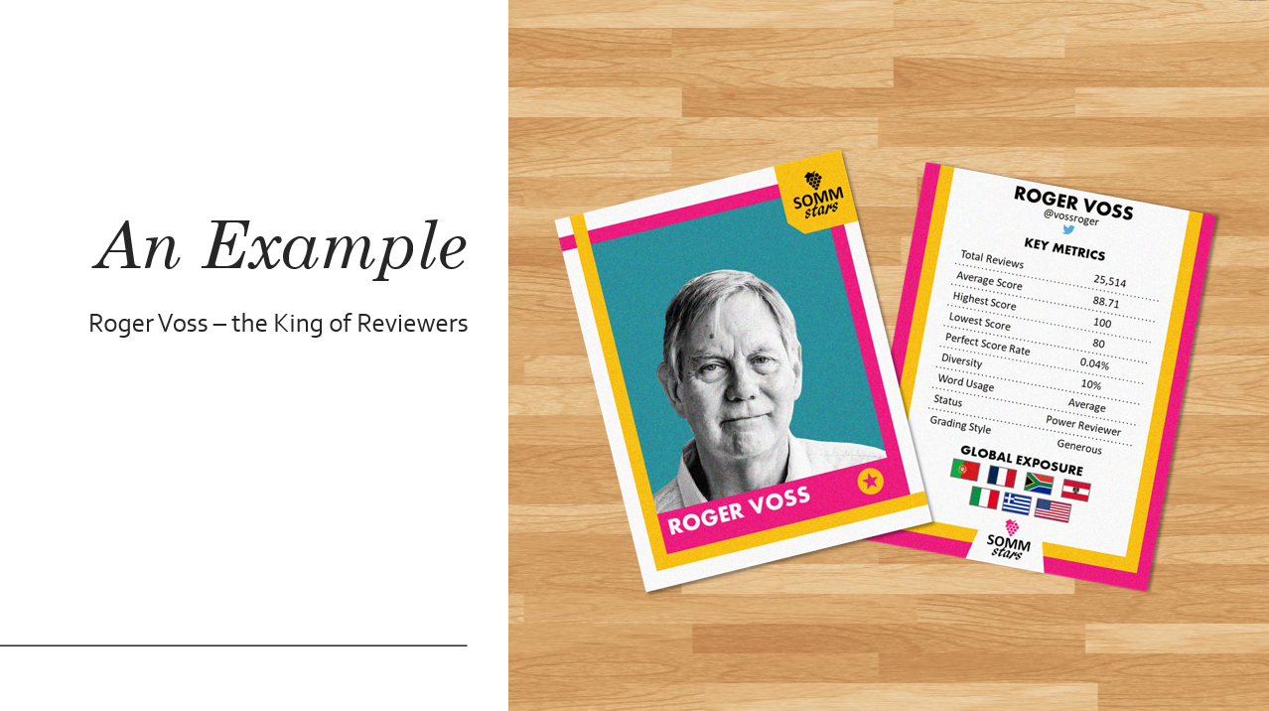

Slide 34


Wine Variety Analysis
Incorporated Text Mining & NLP Components (Python NLTK library)
Text mining ​is the process of deriving high quality information from text.
Goal is to turn the text into data for analysis via application of NLP.
NLP - Natural Language Processing
“Natural language processing (NLP) is a branch of artificial intelligence that helps computers understand, interpret and manipulate human language.” - SAS
Text mining ⇒ information
NLP ⇒ knowledge
Notes:
Start by adding “we wanted to be able to boil down and analyze lengthy paragraphs into a small list of words, which also led to more efficiency in the analysis.”

Slide 35

Wine Variety Analysis
...Continued
Tokenization​ is the process of breaking strings into tokens of small structures or units
“She sells seashells by the seashore”
⇒ [“She”, “sells”, “seashells”, “by”, “the”, “seashore”]
Stop words​ are common “connector” words. These words do not provide any meaning and are best removed.
examples: “the”, “a”, “at”, “for”, “above”, “on”, “is”,“all”

Slide 36
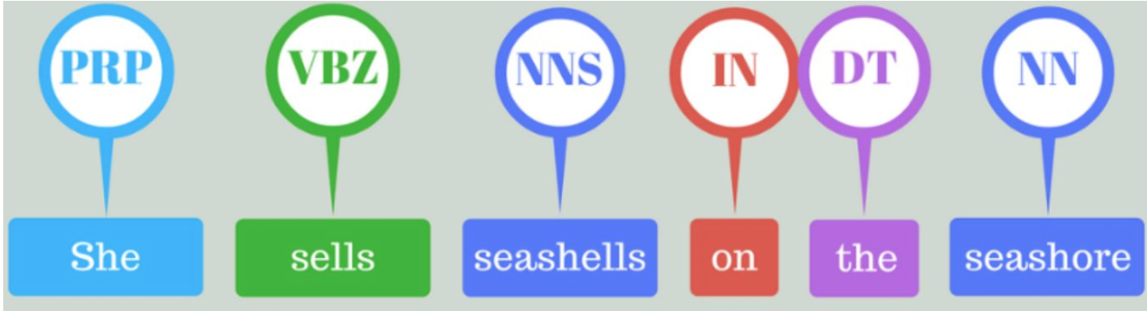
Wine Variety Analysis
...Continued
Part-of-speech understands and matches parts of speech to each tokenized word in a text (adjectives, adverbs, nouns, verbs, etc).
Source: Dhilip Subramanian

Slide 37
Word Dictionary Creation for Descriptions
Applying NLP to Wine Tasting Reviews
Identified the column of interest. ⇒ “The happy jumping dog”
Used tokenization to break up paragraph into a list of words. ⇒ [“The”, “happy”, “jumping”, “dog”]
Filtered out stop words from each list of text. ⇒ [“happy”, “jumping”, “dog”]
Appended the part-of-speech to each word. ⇒ [ [“happy”, ADJ], [“jumping”, V], [“dog”, N] ]
Filtered parts of speech for only nouns and adjectives. ⇒ [ [“happy”, ADJ], [“dog”, N] ]
* ADJ = Adjective, N = Noun, V = Verb

Slide 38
Wine Variety Analysis
Creating Wine Flavor Word Dictionary
“Fruity”, “Earthy”, “Floral”, “Bitter” examples of how one might describe a wine.
Created word lists for each category ⇒ [Fruity: “apple”, “pear”, “juicy”]
If descriptor list had enough matches, considered wine apart of that category.
Wine could live in more than one category (i.e. “sweet” and “earthy”)

Slide 39
Wine Type Analysis
Identified the columns of interest -- title, designator, grape variety, description
Matched title and designator to list of color words in English, French, Italian, Spanish and German
Matched grape variety to list of grape variety colors
Matched description to list of color words
Count weighted matches and assign color with the highest count
Add “Blend” and “Sparkling” designations

Slide 40
Wine Type Analysis
Red => [noir, rotwein, rosso, rouge]
White => [blanc, bianco, bianca, weißwein, weis]
Rosé => [rosato, rosado, rosat, roséwein, roséfine]
Sparkling => [champagne, bubbles, bubbly, brut, bruto, sekt, schaumwein, effervescent, spumante, scintillante]
Red grapes => [cabernet, malbec]
White grapes => [sauvignon blanc, chardonnay, riesling]
Ambiguous grapes => [pinot noir (blanc), chardonnay (noir), pinot gris (mendoza)]

Slide 41
Sample Recommendation
Cavas Hill NV 1887 Rosado Sparkling (Sparkling Rosé Blend from Spain) $13 | 82 Points | Sweet, Light-Bodied Red in color, with berry and apple aromas, this is a sweet blend, with a light body and nose tingling effervescence.

Slide 42
Wine Recommender Terminal App
Collect user preferences
Wine Type
Flavor Profile
Taster Score
Price Range
Origin Country
Display 10 Results
Wine Title
Wine Type
Flavor Profile
Taster Score
Price
Origin Country
Description
Pandas Filtering

Slide 43
Tableau Dashboard
Tableau is a data visualization tool that makes it easy to create interactive visual analytics in the form of dashboards for both technical and non-technical end users.
Notes:
Once we finished the python portion with the wine recommender we wanted to explore visualization options.
In an effort to grow visualization skills and create a user friendly interface we used decided to create a tableau dashboard
Tableau is a data visualization tool that makes it easy to create interactive data analytics. By creating a tableau dashboard with the final wine data set we created -- users can ask their own questions, such as what country has the most expensive wine and what varieties have the most points.

Slide 44
Putting it All Together: Sample Use Case
User is traveling to Spain and wants to learn about Spanish wines before their trip!
Data Scientists perform initial analysis, data transformations, and create a Wine Recommender
User specifies wine preferences and receives a Top Ten List of wine recommendations
User combines information from Wine Recommender and Tableau Dashboard to select a Taster Trading Card!
User uses Tableau Dashboard to dive deeper into their Top Ten List of wine recommendations
Notes:
https://www.gettyimages.com/illustrations/traveler?family=creative&mediatype=illustration&phrase=traveler&sort=mostpopular
Wine glasses clip art hostted 2 - Cliparting.com
So -- how can we put this together

Slide 45
Wine Recommender: Use Case
User specifies a preference for Spanish wines and receives a Top Ten list of wine recommendations for wines from Spain.
Where can the user go to learn more about Spanish wines?
Original user input, user selects Spain
Output, user receives Spanish wine recommendations

Slide 46
Tableau Dashboard: Use Case
User Input:
User selects Spain from the Map to display information about wine from Spain.
User Insights:
Spain has 9 varieties, with Red, White, and Red Blend accounting for over half of Spain’s total wine.
The most expensive wines from Spain are Red Blends. Red Blends also have, on average, the most points.
Five tasters have reviewed wine from Spain, with Michael Schachner having the most reviews -- does Michael try wines from other countries?
Original user input, user selects Spain

Slide 47
Tableau Dashboard: Use Case Continued
User Input:
User selects Michael Schachner: does Michael try wines from countries other than Spain?
User Insights:
Michael Schachner tries all different varieties of wine from countries all over the world.
Michael Schachner gives the most points to Red Blends and mostly reviews Red and White Wines.
Where can the user go to learn more about Michael Schachner?
Original user input, user selects Michael Schachner

Slide 48
Taster Profile: Use Case
After filtering the Tableau Dashboard to show information about Michael Schachner, a user can learn even more about Michael by getting a copy of his taster’s trading card!
...

Slide 49
Conclusion
Goal: Create a system that takes input from the user regarding their taste preferences and returns a list of recommended wines.
Results:
Terminal Input Wine Recommender
WineEnthusiast Tableau Dashboard
Taster Profiles
Future Steps:
Web scrape updated wine reviews from Wine Enthusiast

Slide 50
Thank you!

Slide 51
BACKUP

Slide 52
Putting it all Together
Goal: provide a platform for users to:
Receive wine recommendations based on their personal taste preferences
Visualize and interact with wine review data
Obtain information about their favorite wine tasters
Results:
Terminal Input Wine Recommender
WineEnthusiast Tableau Dashboard
Taster Profiles

Slide 54
Backup

Slide 55
Make a wine predictor -- user inputs criteria and wine predictor returns wine that meets their criteria and a recommendation for a wine taster to follow on social media
What criteria does the user input
How many recommendations does the user get

Slide 56
Exploring the data
Questions to ask:
Price
What are most of the wines priced at
What are the most/least expensive varietals --- change with Nikki’s simplified categories
Where do the most/least expensive wines come from
Points
What is the average point score
What varietals get the most/least points --- change with Nikki’s simplified categories
Where do the wines with the most/least points come from
Tasters
Are any of the taster’s biased
Average # of points, standard deviation
What tasters write the most reviews
Do more expensive wines have higher points
Cleaning:
Any null values
Any outliers (ex. 3000 bottle of wine)

Slide 57
Variables

Slide 58
Cleaning data is na?
Notes:
print(df.isna().sum())
#clean data - no nulls
#df.price.dropna(inplace = True)
#df.fillna("",inplace = True)

Slide 59
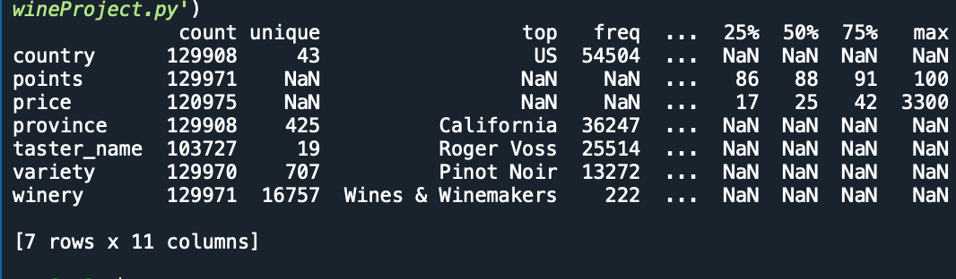
Describe data
Notes:
print(df.describe(include='all',).T)

Slide 60
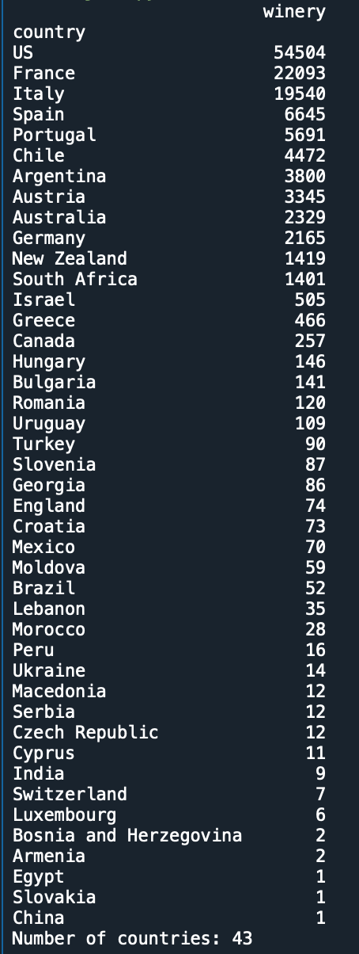
How many wineries in each country?
Notes:
#make wineries varaible
wineries = df[["winery", "points", "price"]].groupby(by="winery").mean()
countries = df[ ["country", "winery"] ].groupby(by="country").count().sort_values(by="winery")[::-1]
print(countries)
print( "Number of countries: "+str(len(countries)) )

Slide 61
Wine Taster Review Count

Slide 62
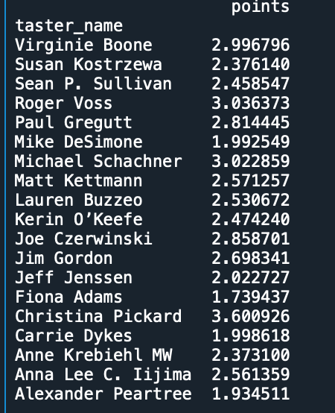
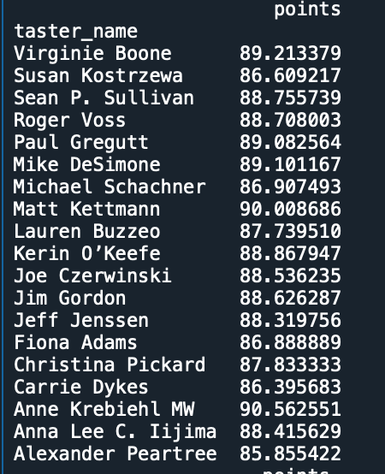
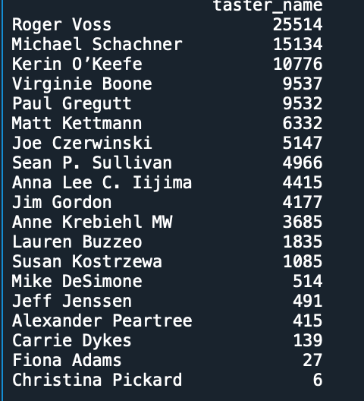
Taster Bias
Notes:
#look at the tasters -- are they biased?
#average mark by a taster
tasters = df[ ["taster_name", "points"] ].groupby(by="taster_name").mean()[::-1]
print(tasters)
#standard deviation by taster
print( df[ ["taster_name", "points"] ].groupby(by="taster_name").std()[::-1] )

Slide 63
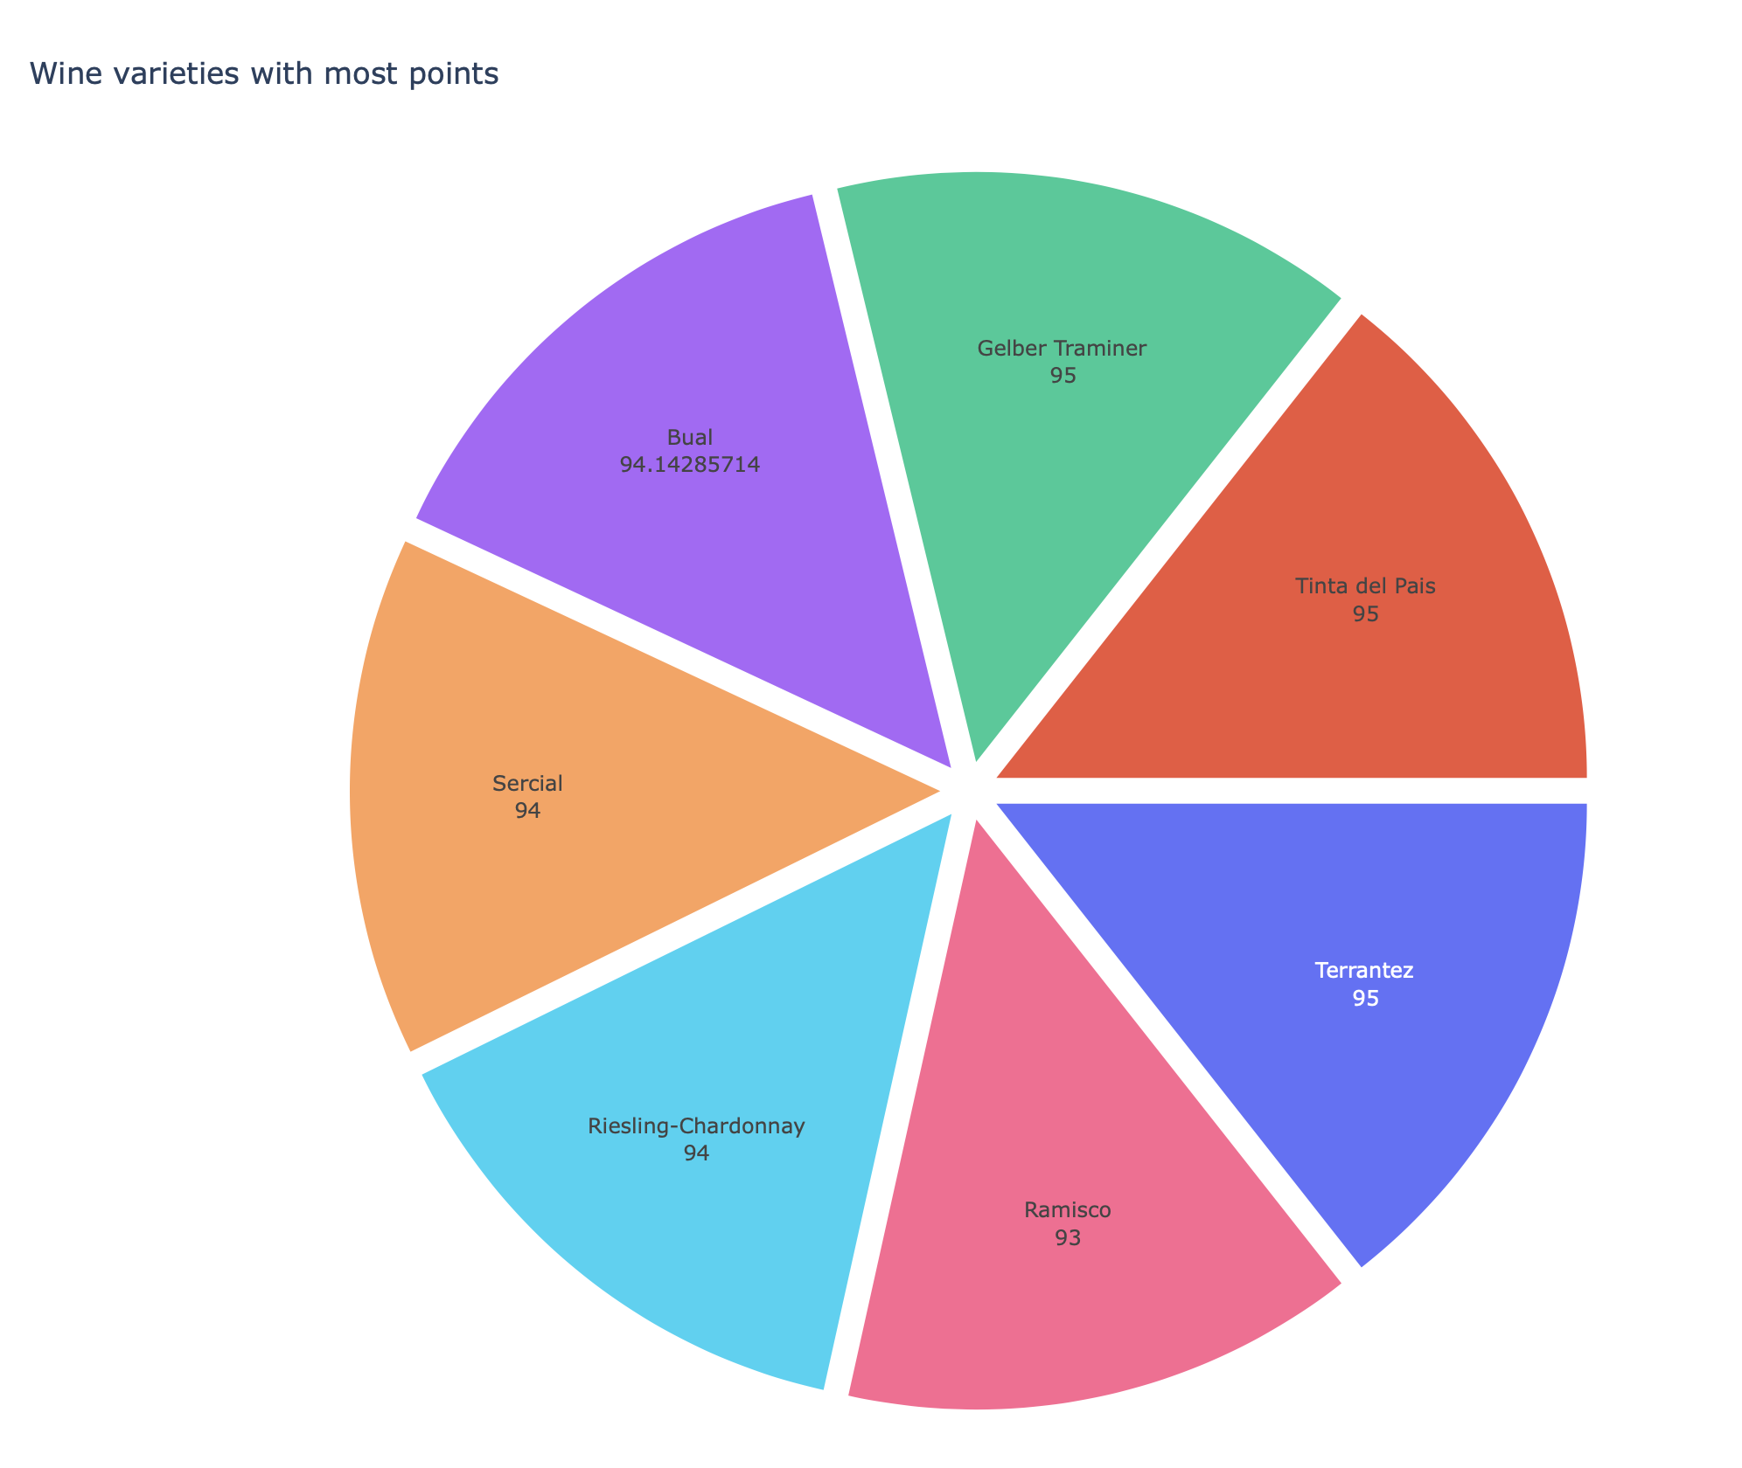
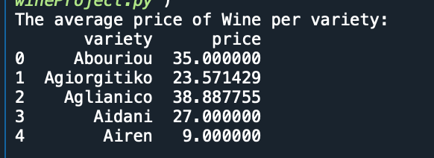
Wine Variety By Price ** Change with Nikki’s Categories
Notes:
#look at the wine variety -- does it influence the price? Option for stat test here
#compare wine variety to prices
dfVariety = df.groupby('variety')['price'].mean().reset_index()
print("The average price of Wine per variety:" + '\n' + str(dfVariety.head()))
#which wine variety has the most points
dfVarietyGrouped = df.groupby('variety')['points'].mean().reset_index()
print("The wine variety with most points:" + '\n' + str(dfVarietyGrouped.head()))
dfVariety = dfVarietyGrouped.sort_values('points', ascending = False)[0:7]
varietyPointPie = px.pie(values=dfVariety['points'], names=dfVariety['variety'], title='Wine varieties with most points')
varietyPointPie.update_traces(rotation=90, pull=0.05, textinfo="label+value")
#varietyPointPie.show()
plot(varietyPointPie)

Slide 64
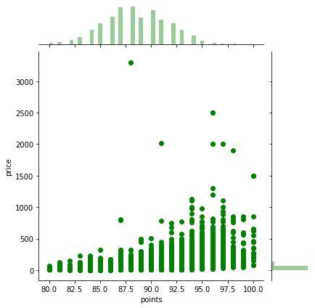
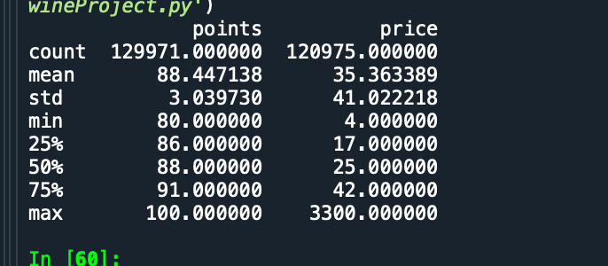
Points and Price
Notes:
#plot each winery comparing points to prices
points = wineries["points"]
prices = wineries["price"]
plt.plot(points, prices, "r.")
plt.title("Points and prices in wineries")
plt.xlabel("Points")
plt.ylabel("Prices")
sns.jointplot( x = df['points'],y = df['price'],color='g');
print(df.describe())

Slide 65
Notes:
#look at country, which one has the most expensive wine
#which counrty most expensive wine
dfCountry = df.groupby('country')['price'].mean().reset_index()
print("The average price of Wine per country: " + '\n' + str(dfCountry.head()))
dfCountry = dfCountry.sort_values('price', ascending=False)[0:10]
countryPie = px.pie(names=dfCountry['country'], values=dfCountry['price'], title='Countries that produce expensive Wines')
countryPie.update_traces(rotation=90, pull=0.05, textinfo="percent+label")
#countryPie.show()
plot(countryPie)

Slide 66
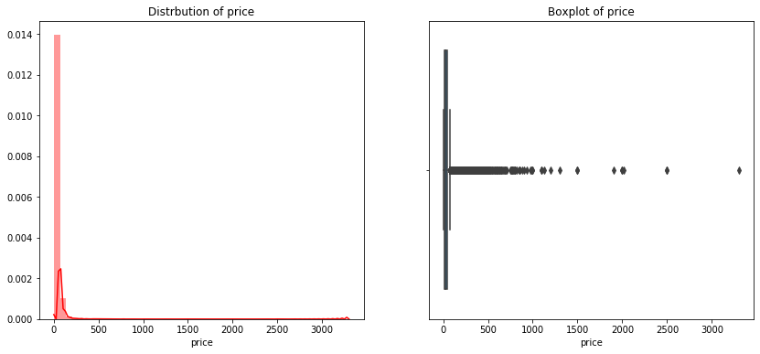
Price Distribution
Notes:
#wine by price distribution
f, ax = plt.subplots(1,2,figsize=(14,6))
ax1,ax2 = ax.flatten()
sns.distplot(df['price'].fillna(df['price'].mean()),color='r',ax=ax1)
ax1.set_title('Distrbution of price')
sns.boxplot(x = df['price'], ax=ax2)
ax2.set_ylabel('')
ax2.set_title('Boxplot of price')
The price of wine is starts from 4 to more than 3000.
The price mean and median price is less than 100,
there are many outliers in the data

Slide 67
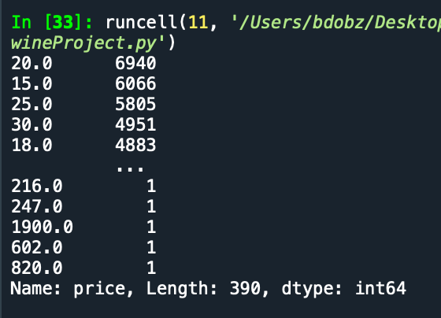
Top wine prices
Notes:
#get top wine prices of the data set
temp_df = df.price.value_counts()
print(temp_df)

